Slide 1
Sales360 Analysis- A Case Study
Prepared by :
B5_Nikhil_Gupta
B5_Sahith_Varma
B5_K_Avinash_Nayak
B5_Pramath_Sahoo

Slide 2
Problem Statement:
This case study project focuses on enhancing the shopping experience in the Geocart e-commerce app. It involves designing and implementing a robust data pipeline to process and analyze a large dataset of customer orders. The goal is to predict user behavior, such as repeat purchases and new product trials, to optimize the shopping journey. The project aims to create an efficient and scalable data engineering solution that integrates with machine learning models for real-time predictions, improving Geocart's user experience.

Slide 3
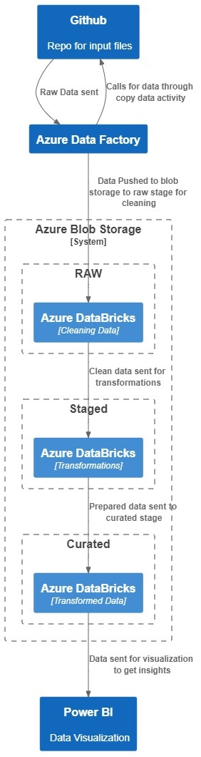
Architecture Diagram:

Slide 4
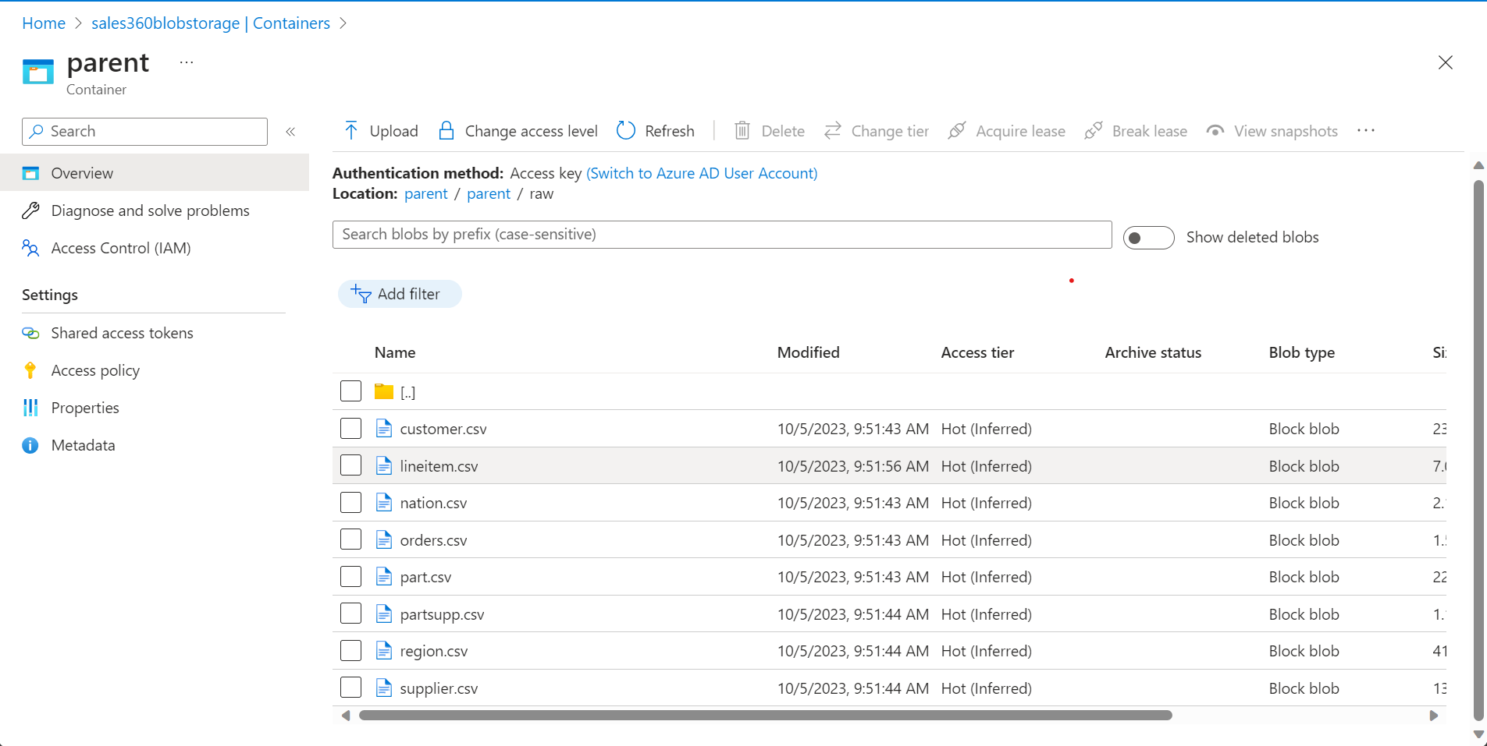
Raw Data:

Slide 5
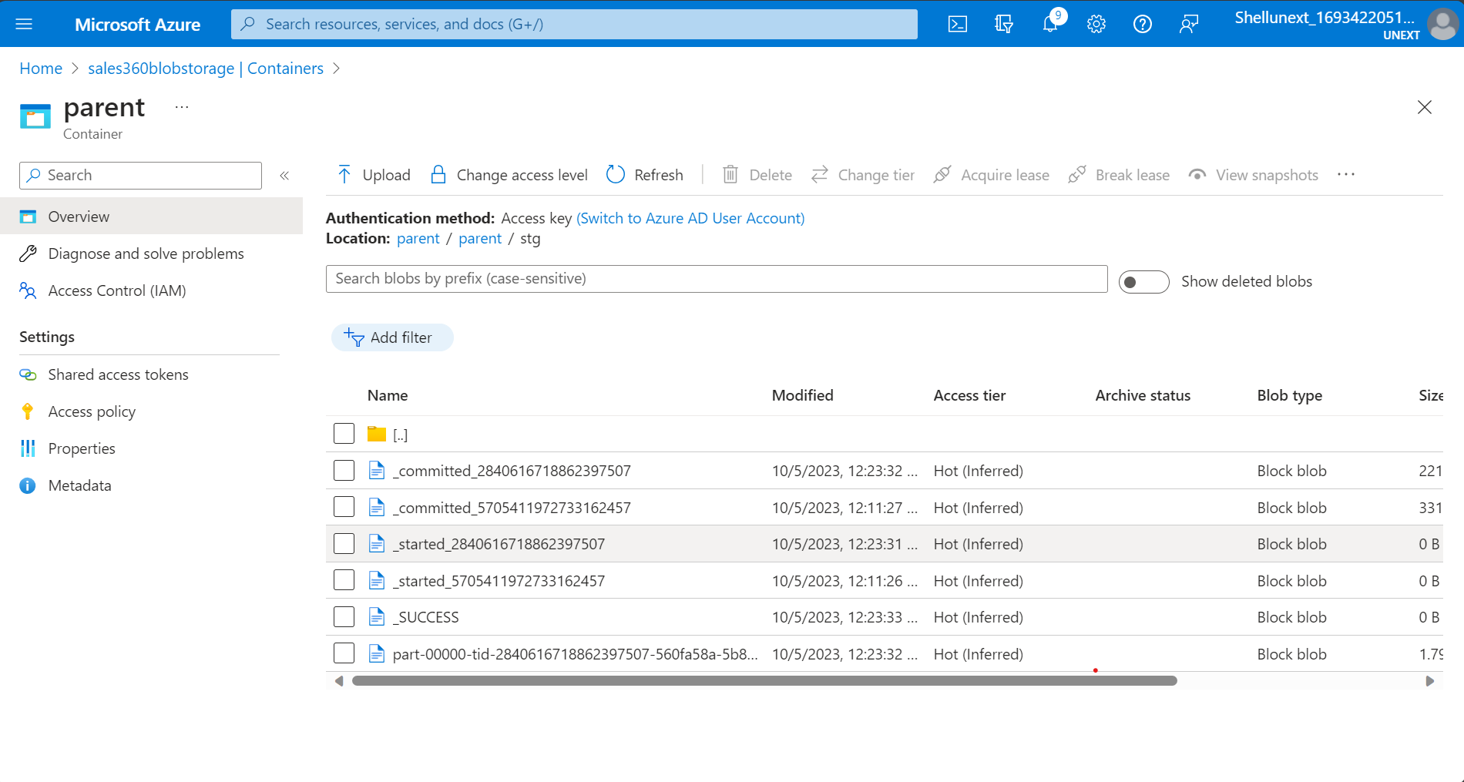
Staged Data:

Slide 6
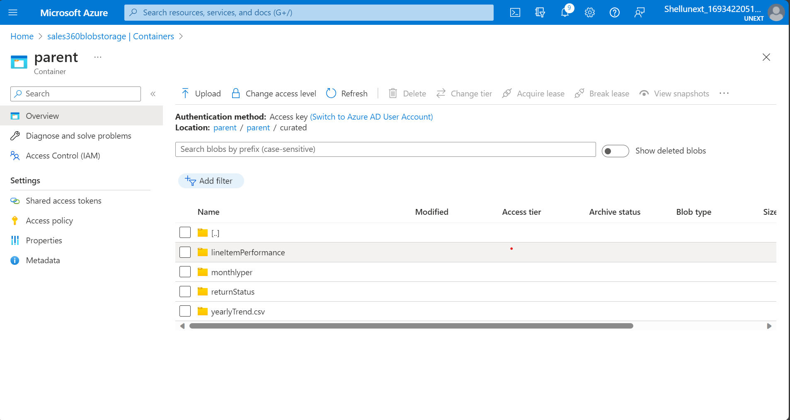
Curated data:

Slide 7
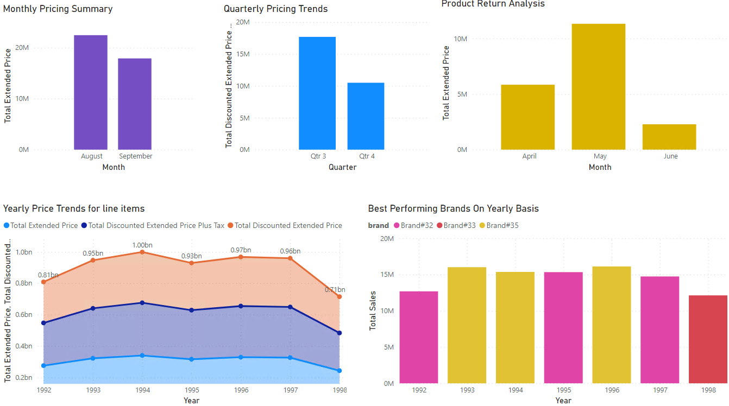
Power BI Dashboard:

Slide 8
System Demo

Slide 9
Challenges Faced:
Understanding the specific requirements of the project, which we felt were vague.
Operating within the stipulated time frame.
Planning and deciding on an architecture.
Learnings:
We got to learn how the various technologies involved in a data engineering project work together.
Performed Data Collection, Data Transformation, Data Integration, Data Ingestion, among many other processes.
We learnt to work as a team and coalesce individual ideas and strengths.

Slide 10
Github Link:
kan12340987/Sales360Repo (github.com)

Slide 11
Thank You

Slide 12
Q&A

